Slide 1

SALES FINANCIAL DATA ANALYSIS

Slide 2
About the dataset
Contains columns: Retailer, Retailer ID, Invoice Date, Region, State, City, Gender Type, Product Category, Price per Unit, Units Sold, Total Sales, Operating Profit, Operating Margin, Sales Method.
Covers several brands and sales channels, e.g., Foot Locker, Amazon, Sports Direct, Walmart
Includes financial data:
Units Sold and Price per Unit to compute Total Sales.
Operating Profit and Operating Margin for profitability insights.
4. Extensive geographic coverage: major cities and regions, retail types, and genders are all included.

Slide 3
Initial Observations
Data is granular: line-by-line transactions, enabling detailed analysis of specific sales dates, product types, and performance by region and retailer.
No systemic missing values evident in sampled rows; all major fields are populated.
Operating margin varies by product category and method, showing differences in profit efficiency across products, regions, and channels.
This dataset is suited for exploratory analysis, profitability modeling, sales trends, regional comparisons, and performance benchmarking across Adidas retail and e-commerce operations.

Slide 4
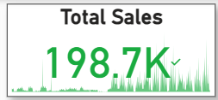
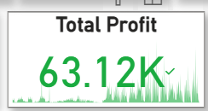
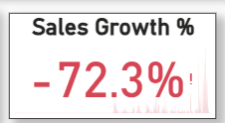
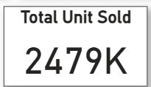
KPI Card View
The KPI cards display summary statistics:
Total Sales: 198.7K (in green), representing the overall revenue for the selected period.
Total Profit: 63.12K (in green), showing profitability during the same period.
Sales Growth %: -72.3% (in red), which means there’s a significant decline in sales compared to the previous period. The red color is a visual indicator of negative growth, signaling a performance concern.
Total Units Sold: 2,479K, highlighting total product volume moved.

Slide 5
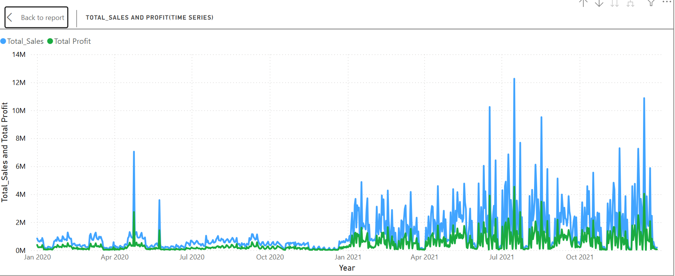
Total Sales and Profit (Time Series)
This line chart shows the trend of total sales (blue) and total profit (green) over time from January 2020 to December 2021.
Each spike or dip represents high or low sales periods, highlighting the seasonality and key growth points. For example, sales peak at 12.3 million at one point, indicating a major sales event or promotion.
Profit generally follows sales trends, showing business profitability alignment with revenue over time.

Slide 6
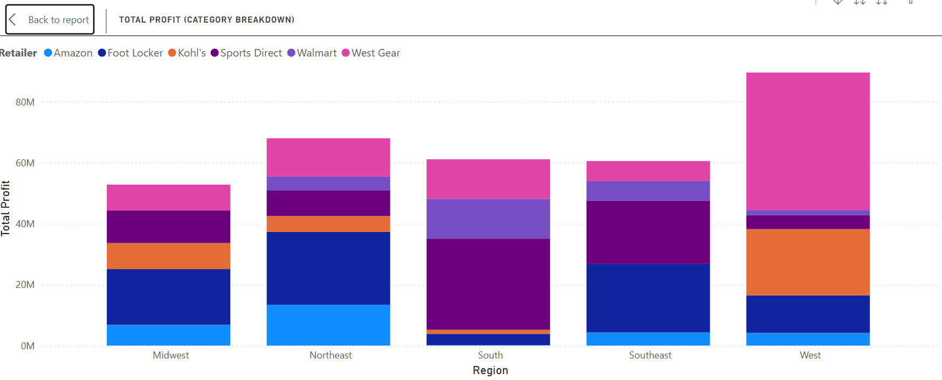
Total Profit Category Breakdown by Region
This stacked bar chart analyzes total profit across five major U.S. regions and separates it by retailer.
Each colored block represents a retailer’s contribution, such as West Gear leading in the West region with 45 million profit, while Walmart and Sports Direct dominate in the South and Southeast.
The graph helps identify high-performing regions and major retail contributors to Adidas’s profit.

Slide 7
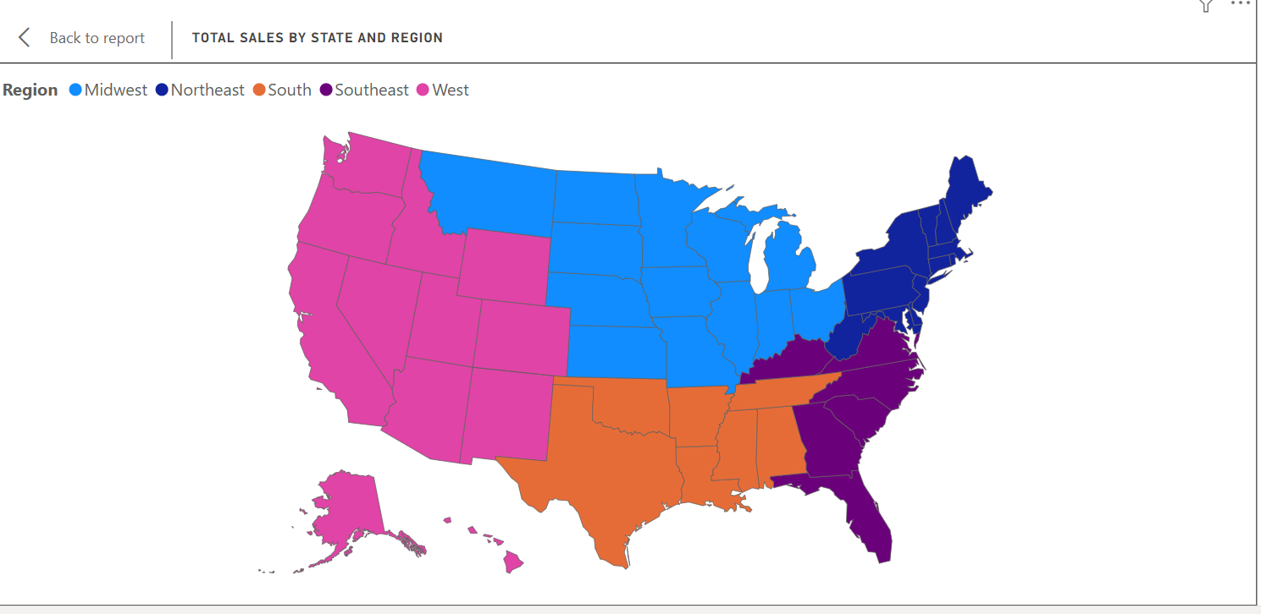
Total Sales by State and Region (Map)
This filled map visualizes total sales by state, colored by region: Midwest, Northeast, South, Southeast, and West.
It clearly depicts regional sales strengths, with the West and Midwest regions accounting for large sales volumes.
The map helps geographically pinpoint where Adidas performs best across the U.S.

Slide 8
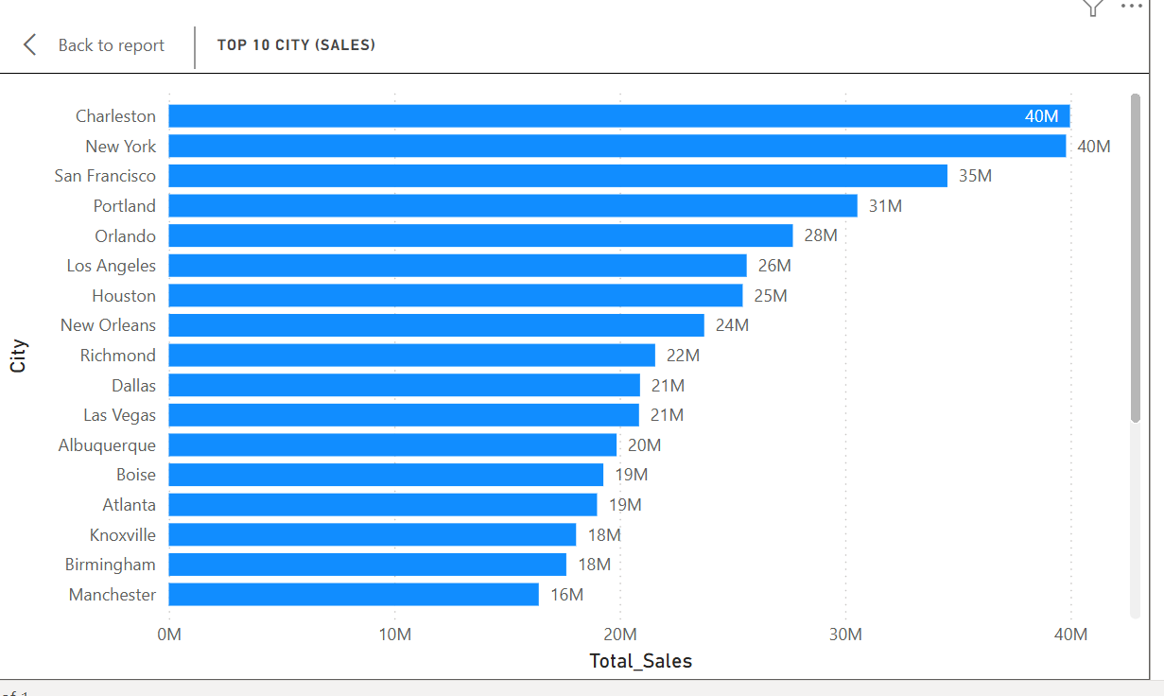
Top 10 Cities by Sales (Horizontal Bar Chart)
This bar chart ranks the top 10 cities for total sales, showing Charleston and New York at 40 million each, followed by San Francisco and Portland.
The graph provides insight into geographic markets driving Adidas’s revenue and aids strategic decisions for distribution and marketing.

Slide 9
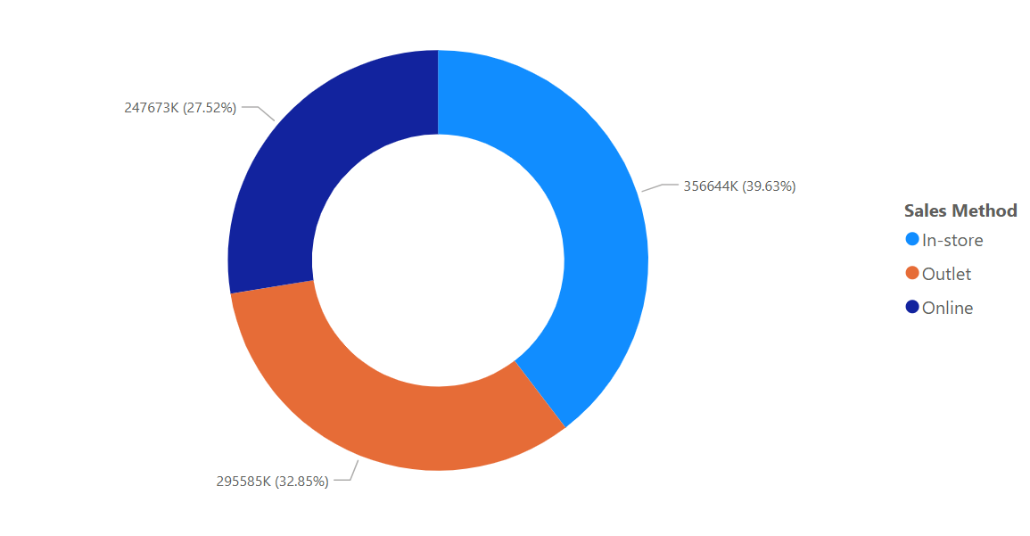
Total Sales by Selling Method (Donut Chart)
This donut chart breaks down total sales by selling method: In-store (39.63%), Outlet (32.85%), and Online (27.52%).
In-store sales are the highest, followed by Outlet and Online.
This comparison helps understand sales channel performance and where focus may be needed for growth.

Slide 10
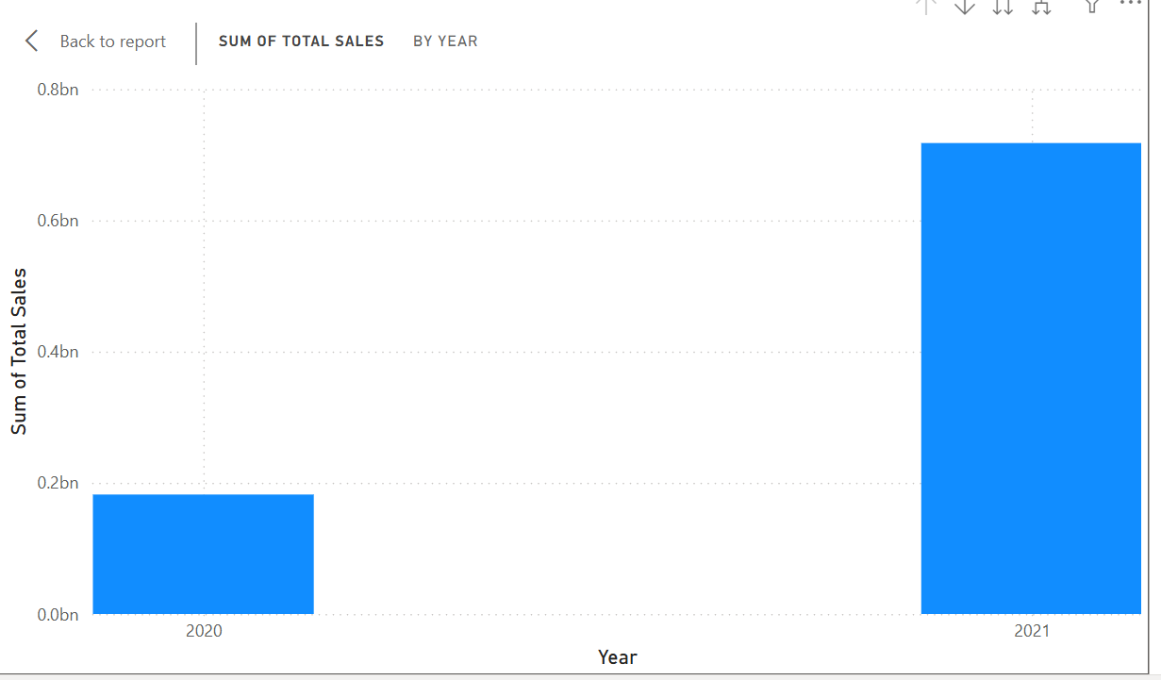
Annual Sales Overview (Bar Chart)
This bar chart compares the sum of total sales by year (2020 vs 2021).
The graph shows a substantial increase in sales in 2021, with total sales rising from about 0.2 billion in 2020 to over 0.7 billion in 2021.
This dramatic growth indicates successful business expansion or strong recovery in 2021.

Slide 11
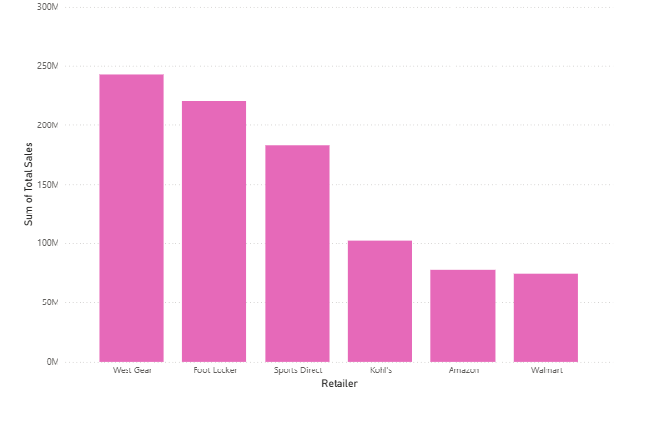
Sales by Retailer (Bar Chart)
This straightforward bar chart shows the sum of total sales by retailer.
West Gear is the top performer, followed by Foot Locker and Sports Direct, while Kohl's, Amazon, and Walmart have lower sales.
This visualization is excellent for benchmarking retailer performance.

Slide 12
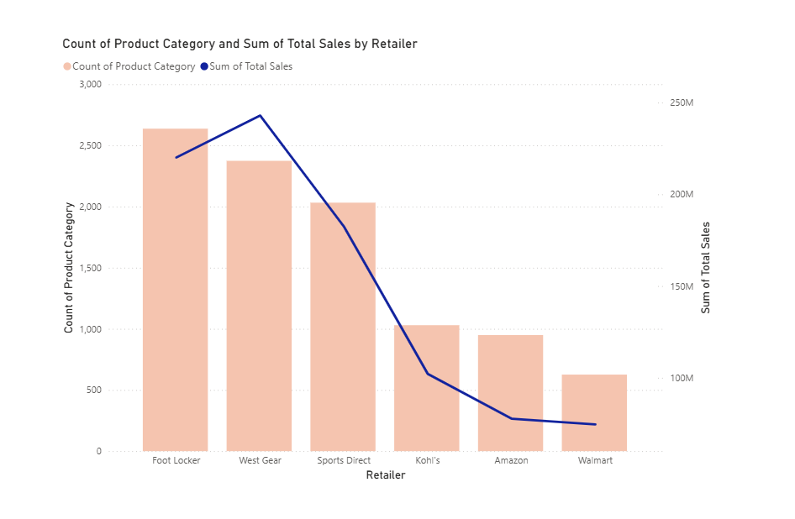
Product Category vs Sales by Retailer (Combo Chart)
This combo chart uses bars for the count of product categories and a blue line to represent total sales across different retailers.
Foot Locker and West Gear have the highest variety (category count) and sales volumes, while Amazon and Walmart lag behind.
The chart shows which retailers offer diversity and drive revenue.

Slide 13
Key Insights
Strong overall sales growth from 2020 to 2021 demonstrates business expansion and market recovery.
Recent sales growth is negative (-72.3%), signaling possible challenges or market fluctuations.
West Gear, Foot Locker, and Sports Direct are top retailers driving sales and profit.
Product category diversity among retailers correlates with higher sales volumes.
Geographic and sales channel variations offer actionable insights for targeted marketing and distribution.

Slide 14
Recommendation and Suggestion
Address Sales Growth Decline
Strengthen Top Retailer Relationships
Expand Product Variety
Focus on Underperforming Regions
Optimize Sales Channels
Enhance Customer Segmentation

Slide 15
Thank You

